Slide 1

A Decentralized online Marketplace Application (Dapp) on the Ethereum Blockchain

Slide 2

Team Members(B22BH01)
Sri Ritwik Chekuri(S20190010032)
Bhima Shankar Devarakonda(S20190010044)
Mahesh Chennaboina(S20190010033)
Mentor : Dr. Bheemappa Halavar

Slide 3

What is a marketplace?
A place where multiple sellers sell their products, just like a shopping mall.
Online marketplace - provides platform to connect buyers and sellers.
Current big players - amazon, flipkart, ebay etc.

Slide 4
Problems with existing online market places
Product listing/ selling fees
Privacy of user data
Company holds the central position
Third party payment systems
RECAP

Slide 5
Problem Statement
To build an application that is not administration centric, no middlemen and provides utmost security.
So, all the user data(mainly address) must be secured.
User’s transactions must be secure.
Sellers should make maximum possible profits.
Buyers need to buy at minimum affordable prices.
RECAP

Slide 6
Solution
One solution - waiving off the fees.
Making the systems distributed so that there is no central failure.
But we want to use the concept of blockchain.
One thing is it’s the trend right now.
And the main thing is blockchain hints the concept of decentralisation.
Where the power to take a decision is also decentralised unlike traditional systems.
RECAP

Slide 7
What blockchain brings to the table ??
It reduces costs associated with using the platform. Therefore, it is not expensive for the seller to list or sell an item, thereby driving the prices for the buyers down.
Users have the ownership of their data and can safeguard their data.
Replace middlemen and automate the process..
No longer worry about the data breaches.
Finally applications with no central point of failure.
Not to build trust but remove the need for trust.

Slide 8
#Existing System :
A Decentralized Marketplace Application on the Ethereum Blockchain
V. P. Ranganthan, R. Dantu, A. Paul, P. Mears and K. Morozov, "A Decentralized Marketplace Application on the Ethereum Blockchain," 2018 IEEE 4th International Conference on Collaboration and Internet Computing (CIC), 2018, pp. 90-97, doi: 10.1109/CIC.2018.00023.
Description | Tools and technologies used | Test results(RinkeBy test framework)
Kind of a auction based application. Each buyer bids for the product. | Smart contracts- solidity Testing framework - truffle Web3.js - to interact with ethereum node Ganache - local development framework which provides free ether and gas. | Average time taken for Transaction is 3.8sec. Gas consumption for transaction is 4.6 gwei. Contract creation time is less than 1 sec.

Slide 9
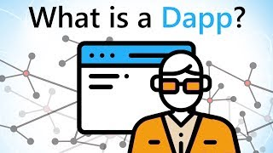
Work done after mid
Got to know what dApps are!
Digital applications that run on a blockchain or peer to peer network of computers instead of single computer.
Promotes user privacy, resists censorship
Ethereum - a platform to develop dapps.
Dapps use smart contracts for their logic.
Dapps use smart contracts to complete the
transaction between 2 parties instead of relying on centralised authority.

Slide 10
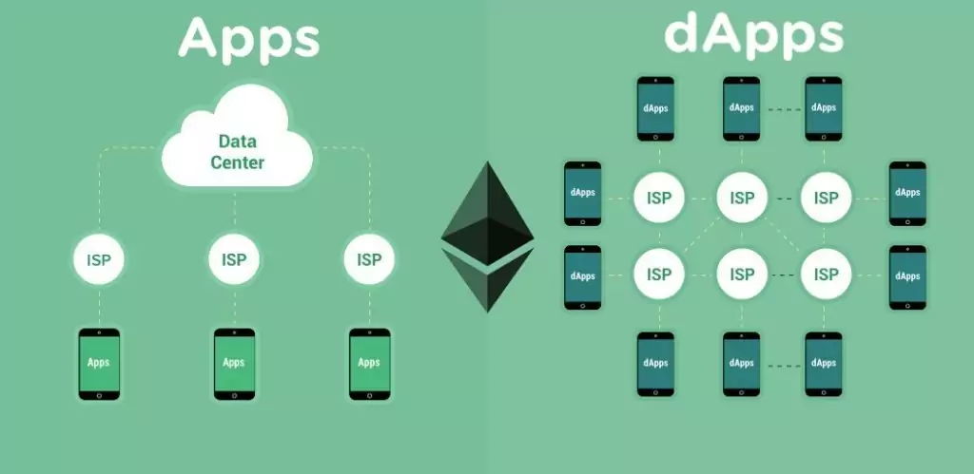
Difference between app and dapp

Slide 11
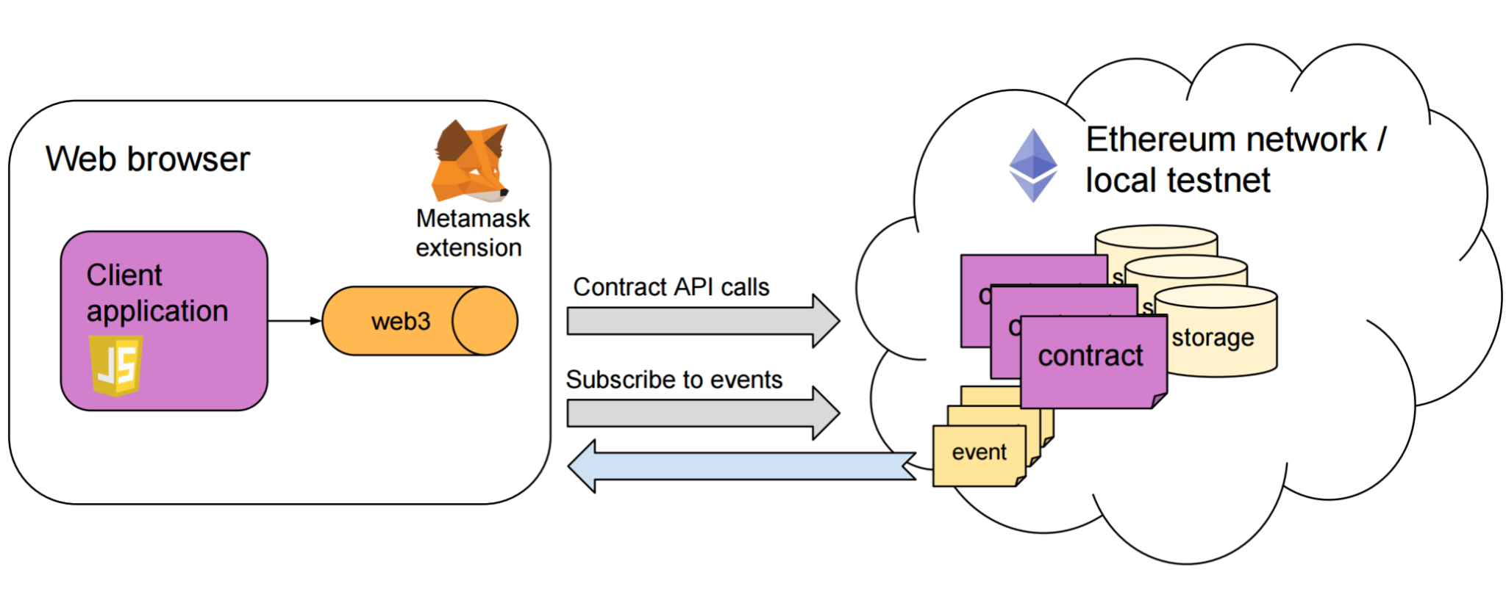
Architecture of a dApp

Slide 12
Smart contracts
Programs stored on a blockchain that run when predefined conditions are met.
Nothing but just a piece of code.
In our case, it contains actions like registering a product, making a transaction, transferring ether between any 2 parties.
They are typically written in a programming language called solidity.

Slide 13
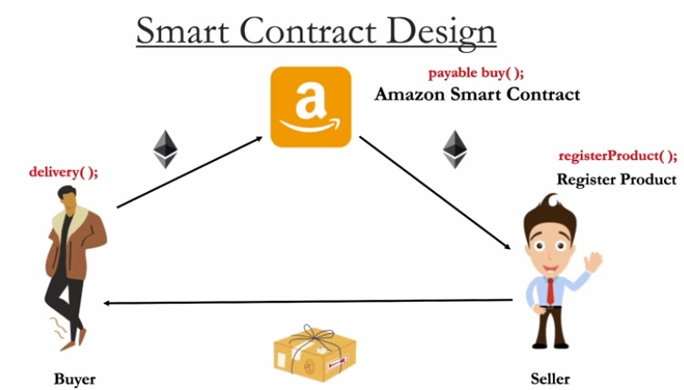


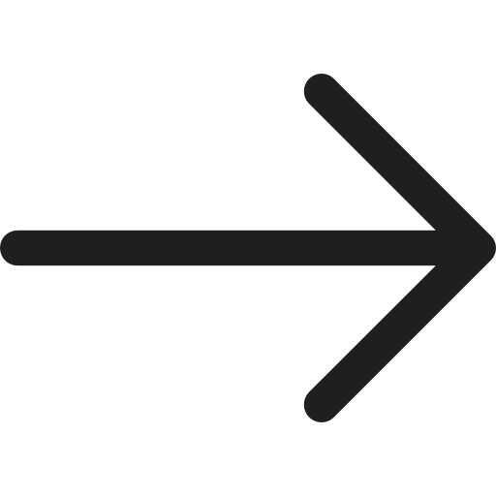
Our Plan

Slide 14
Sample e-com smart contract
So, in the basic smart contract that we implemented in remix, a seller can register his product(consider 1 for simplicity). And it costs him some gas fee.
And a buyer can buy this product by sending some ether.
And this ether will be on hold by the smart contract until the buyer confirms that the product is delivered to him.
Once he confirms, the ether will be transferred to the seller’s wallet.
And a manager of the contract can destroy the smart contract anytime.

Slide 15
Results - observed transaction fees
Gas - unit to measure computational effort required to perform a transaction on the network.
Gas limit - maximum amount of gas that you are going to
to spend in a particular transaction.
Transaction fee = gas limit * gas price per unit(base fee)
Gas limit used here = 3000000
Transaction fees for deploying a contract - 0.00127897692 gwei
Transaction fees for registering product for seller - 0.00017053025 gwei

Slide 16
Timeline
October 2022
March 2022
December 2022
April 2022
Try to complete the implementation of a full-fledged smart contracts.
Proposing problem statement and getting a basic overview of blockchain
Spring semester |  |  |  | Monsoon Semester
Understand about dapps, learn solidity and showcase a sample smart contract.
Testing the final product and to showcase a market ready market place application.

Slide 17
References
Ranganthan, V. P., Dantu, R., Paul, A., Mears, P., & Morozov, K. (2018, October). A decentralized marketplace application on the ethereum blockchain. In 2018 IEEE 4th International Conference on Collaboration and Internet Computing (CIC) (pp. 90-97). IEEE. (Paper)
https://www.edureka.co/blog/category/blockchain/ (Blog)
https://www.youtube.com/watch?v=jxLkbJozKbY&ab_channel=99Bitcoins (video)
https://www.devteam.space/blog/how-to-build-online-marketplace-on-blockchain-like-openbazaar/ (Blog)
https://jimmysong.medium.com/the-truth-about-smart-contracts-ae825271811f (Blog)

Slide 18

–Thank you–
We mean it.

